Slide 1
Online Provider Update
Conduent
Government Healthcare Solutions

Slide 2
Purpose
The purpose of this workshop is to provide an overview of how to submit an online Provider Enrollment Update request via the New Mexico Medicaid Web Portal.
In order to submit updates online, create a Master Administrator account or ask the Master Administrator to create a new user account for you. Instructions starting on slide 5 of this presentation.
If you are unsure who the Master Administrator is for your office or group, please contact the Consolidated Customer Service Center (CCSC) at 1-800-299-7304.

Slide 3
Objectives
We will review the following:
Creating a Master Administrator or New User account on the NM Medicaid Portal.
Logging into the NM Medicaid Portal
Advantages of submitting provider updates online
Available online provider updates
Attaching documents to online provider update requests
Addendum for each upload option

Slide 4
Creating a Master Administrator or New User account on the NM Medicaid Portal. Only Master Administrators can create New User accounts.
Conduent
Government Healthcare Solutions

Slide 5
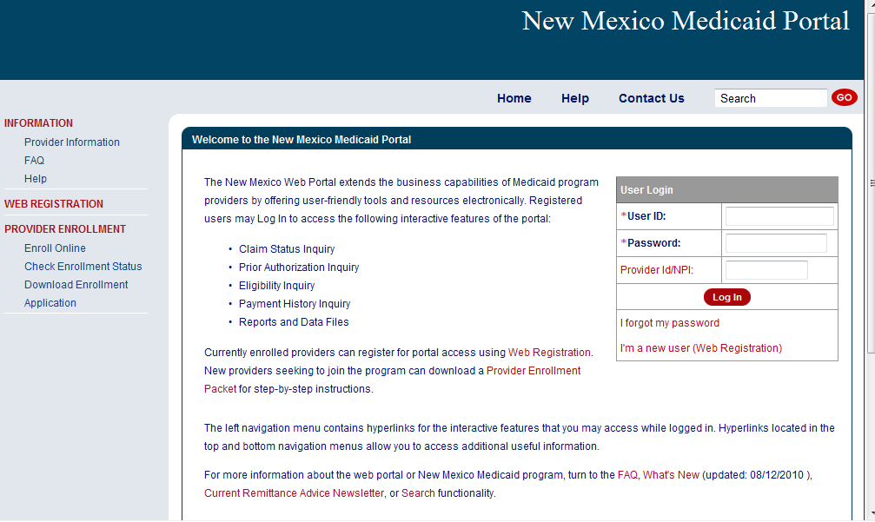
New Mexico Medicaid Web Portal Login
Log in at: https://nmmedicaid.portal.conduent.com/static/providerlogin.htm
Non Secure Features
Notes:
Speaker Notes: Secure versus Non-Secure functions

Slide 6
New Mexico Medicaid Web Portal Login
Log in at: https://nmmedicaid.portal.conduent.com/static/providerlogin.htm
Master administrators (MA) can assign User Rights to others who work closely with Provider enrollment.
Secure Features requires login
An individual can access the Provider Update Security Privilege by contacting their MA.
If you need assistance logging in to the NM Web Portal, please contact Consolidated Customer Service Center (CCSC) at 1-800-299-7304
Notes:
Speaker Notes: Secure versus Non-Secure functions

Slide 7
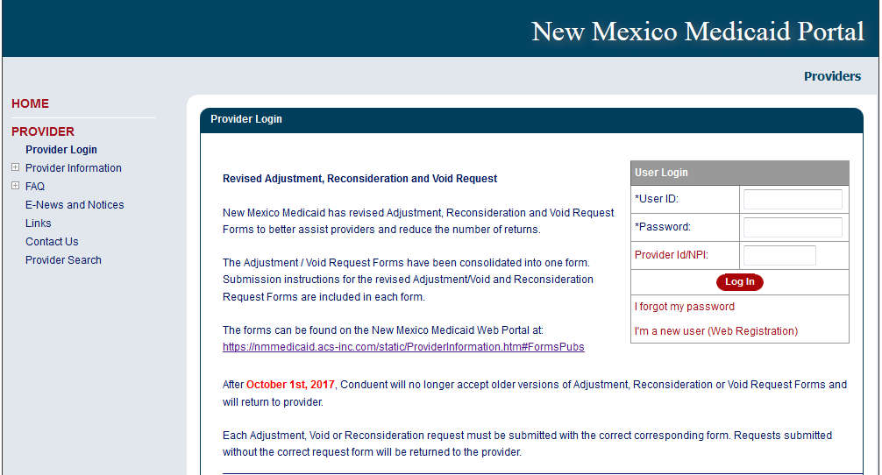
How to Register
Click “I’m a new user (Web Registration)”

Slide 8
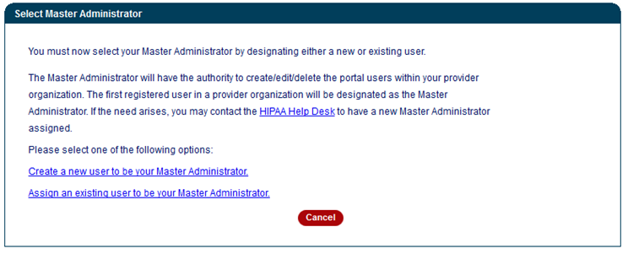
How to Register Continued
Click here to create a User ID on the web portal.
Notes:
Speaker Note:

Slide 9
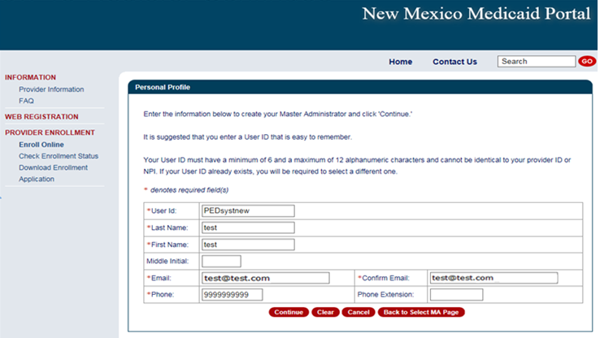
How To Register Continued

Slide 10
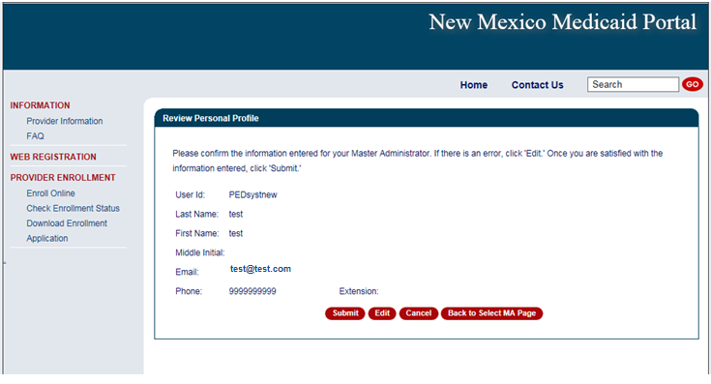
How To Register Continued
Once you have verified your information is correct click “Submit”

Slide 11
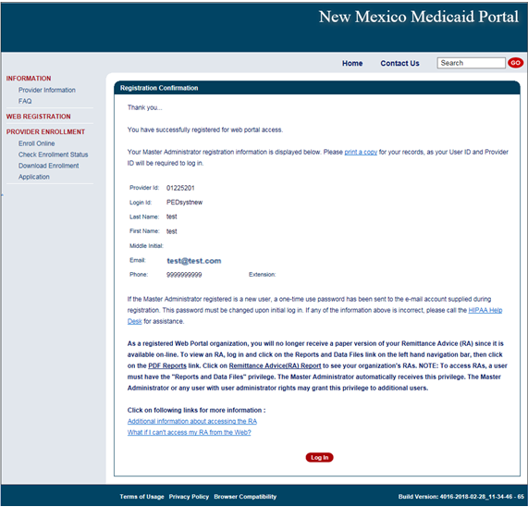
Registration Confirmation Page
NOTE: Write down your user ID before proceeding to the Log In page.

Slide 12
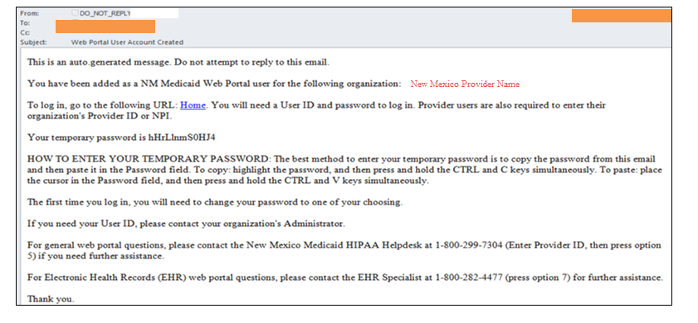
User Confirmation Email
Once you have registered, an initial password will be emailed to you:

Slide 13
User Login
After you receive the user confirmation e-mail, you must log-in to complete your registration. To complete registration, you must enter:
Your User ID (created during the Web Registration process)
The initial password sent to you via email
When you log in for the first time, you will be required to change your
password. The password must meet certain standards that will be described to you on the web page.

Slide 14
After creating a Master Administrator or New User account, updates can now be submitted on the NM Medicaid Portal
Conduent
Government Healthcare Solutions

Slide 15
Advantage of Submitting Updates Online
Submitting update requests online significantly reduces the processing time to 5 business days or less.
Using the online form will ensure that providers are using the most up-to-date version. This will reduce delays in processing of updates.
A confirmation number is provided for better tracking purposes.
Submitting updates via the web portal reduces the chance of documents not being processed.
If you are unsure who the Master Administrator is for your office or group, please contact the Consolidated Customer Service Center (CCSC) at 1-800-299-7304.

Slide 16
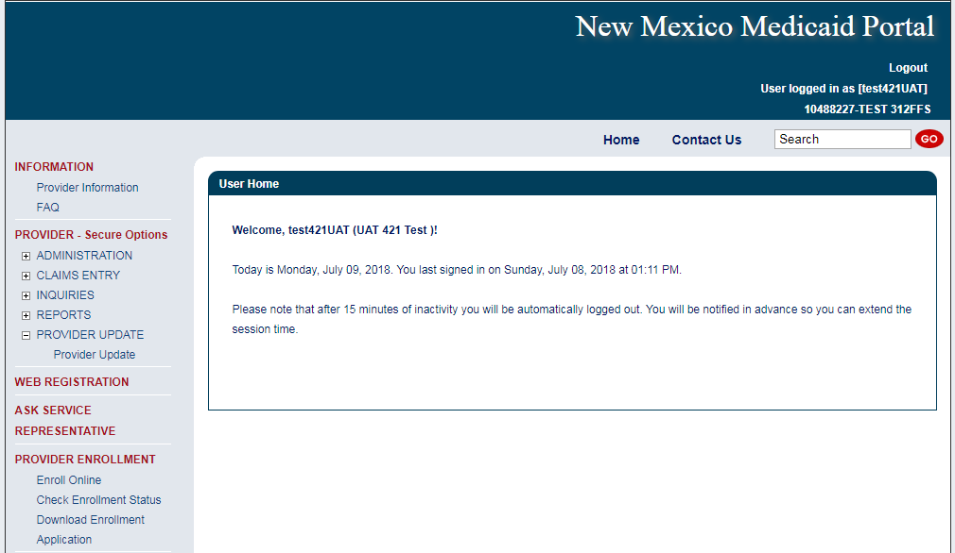
Provider Update
After you have created a Master Administrator or New User account, log into the Nm Medicaid Portal. Remember: Only Master Administrators can create New User accounts.
Notes:
Select “Provider Update.” Location: PROVIDER (Secure Options) > PROVIDER UPDATE > Provider Update

Slide 17
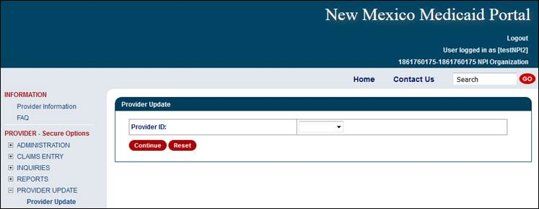
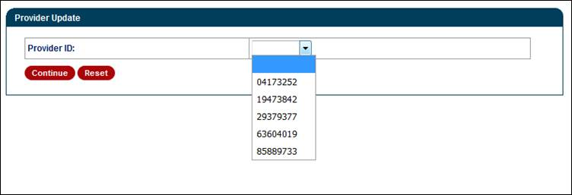
Provider Update Access Continued
Select ‘Continue’ after a provider number has been selected.
Notes:
For Group NPIs – Select the provider number (in which is to be updated) from the drop down option.
Individual NPI – After selecting “Provider Update” from the left window pane; NO option for a drop down selection. It will take you straight to the category section. Examples can be seen in the “Billing and Unrestricted Providers” and “Rendering Providers” sections of this PPT.

Slide 18
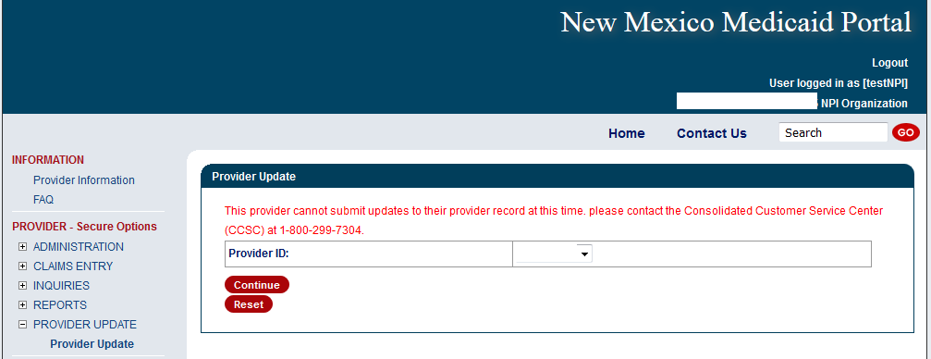
Provider Update Access
Providers can contact the Consolidated Customer Service Center for any errors that prohibits updates from being submitted or to find out who the Master Administrator is for your office or group.
Notes:
The following screen will be shown after clicking the Provider Update option if the update requirements are not met. There are multiple reasons for the message to appear and the best action is for the provider to call the Helpdesk.

Slide 19
Provider Update Access Continued
Upon enrollment with NM Medicaid, providers are classified as billing providers, rendering/servicing providers, or unrestricted providers
Fee for Service billing, rendering, and unrestricted providers will have separate screens tailored to their application needs for updating purposes
Billing Provider - A provider or organization that can bill for a claim
Rendering Provider - A healthcare provider who performs the service(s). Also called 'servicing' provider
Unrestricted Provider - Providers that are billing and servicing providers

Slide 20
Billing and Unrestricted Providers
Conduent
Government Healthcare Solutions

Slide 21
Available Updates Online for Billing and Unrestricted Providers
Name Change: Include a name discrepancy letter with divorce decree or marriage certificate. Must submit an updated professional license.
NPI: May take more than 5 days if related to Type 1 (Individual using SSN) to Type 2 (Entity using TIN) change or may require a new application if related to a change of ownership.
License or Certificate renewal: Attach a copy of the new license or certificate. Providers are termed if an updated license is not received within 90 days of expiration, then have an additional 90 days to reactivate their Medicaid Enrollment by submitting the updated Professional or Business License.
Tax Information and Business Type: May take more than 5 days an may require a new application if related to a new enrollment or change of ownership, where Bill of Sale must be included. If changing to non-profit include the 501c3 letter.
Office or Email Address: E-news letters and other correspondence from NM Medicaid
Add or Term Affiliations: Include add and term effective date. When adding affiliations, include current Certificate of Professional Liability Insurance.
Owner and Manager Information: SSN, DOB and Address are required for Federal Screening requirements. May require a new application if complete change of ownership, where Bill of Sale must be included.
Backdate or Terminate Enrollment: Include backdate and term effective date. When backdating, include Certificate of Insurance covering requested date.
Notes:
Billing Providers and Unrestricted Provider update options
Note: Insurance is only required with affiliations

Slide 22
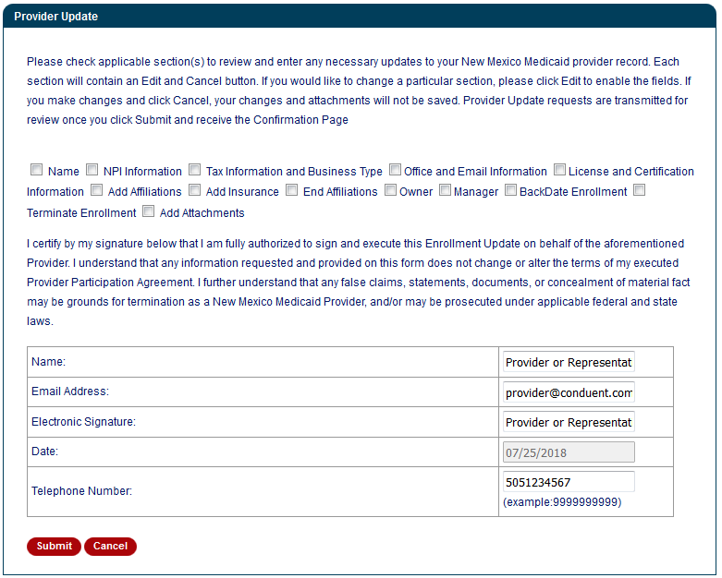
Billing and Unrestricted Providers – Select Update Category
Select all categories that need to be updated.
Please visit the Addendum section of this PowerPoint to learn more on each update option.
These are required fields.
Notes:
Speaker Note: Each option will ask for different information in which is to be updated. More than one categories can be selected per update request

Slide 23
Rendering Providers
Conduent
Government Healthcare Solutions

Slide 24
Available Updates Online for Rendering Providers
Name Change: Include a name discrepancy letter with divorce decree or marriage certificate. Must submit an updated professional license.
License or Certificate renewal: Attach a copy of the new license or certificate.
Office or Email Address: E-news letters and other correspondence from NM Medicaid
Add or Term Affiliations: Include add and term effective date. When adding affiliations, include current Certificate of Professional Liability Insurance.
Backdate or Terminate Enrollment: Include backdate and term effective date. When backdating, include Certificate of Insurance covering requested date.
Notes:
Rendering only provider update options
Note: Insurance is only required with affiliations

Slide 25
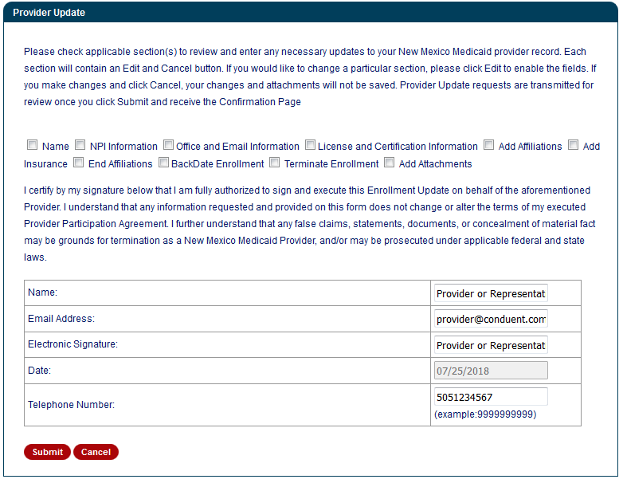
Rendering Providers – Select Update Category
Select all categories that need to be updated.
Please visit the Addendum section of this PowerPoint to learn more on each update option.
These are required fields.
Notes:
Speaker Note: Each option will ask for different information in which is to be updated. More than one categories can be selected per update request

Slide 26
Completing the Request
Conduent
Government Healthcare Solutions

Slide 27
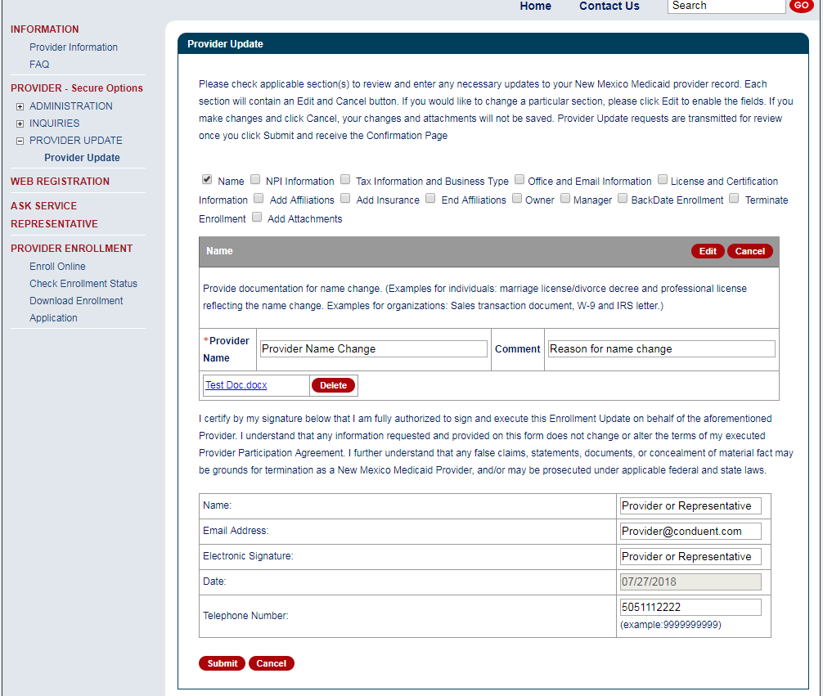
Entering Provider Information
Select ‘Edit’ if you need to add or modify any data.
Add or make changes in the section fields and upload supporting documentation, if required.
Notes:
This upload screenshot is an example of a “Name” update request.
Speaker Note: Edit necessary fields to be updated. Some fields contain data from the provider record (Name, NPI, Tax and Business Type, Office Information, and License and Certification). Other fields are blank and the user can add data (Add and End Affiliations, Owner, Manager, Back date enrollment, and Terminate Enrollment).
Attach pertinent documents using the upload attachment function.
Fill in the certification section after completing all other requested update sections.

Slide 28
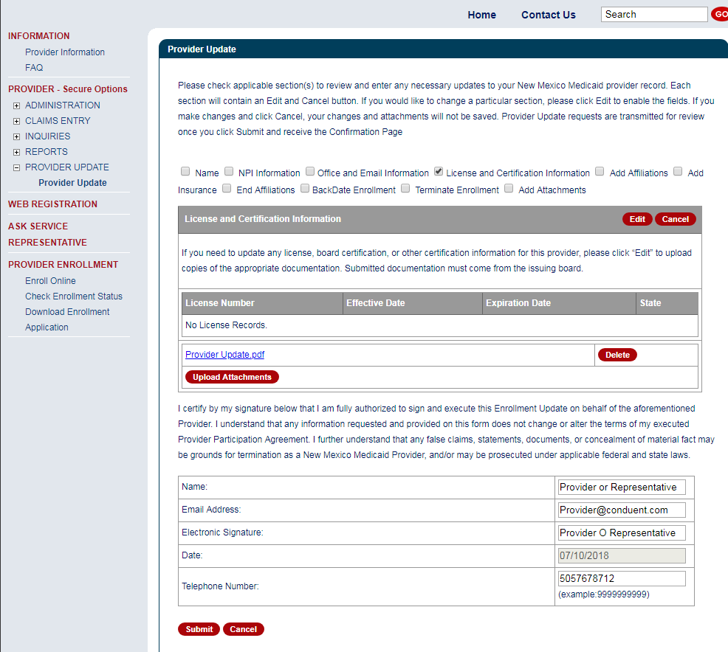
Upload Attachments
Select ‘Edit’ if you need to upload supporting documents.
Then upload supporting documents.
This section must be completed in order to submit the request.
Notes:
This upload screenshot is an example of “License and Certification Information” update request.
Speaker Note: Edit necessary fields to be updated. Attach pertinent documents using the upload attachment function.
Fill in the certification section after completing all other requested update sections.

Slide 29
Submitting or Cancelling the Update Request
Click ‘Submit’ to proceed or ‘Cancel’ to remove changes from the page.

Slide 30
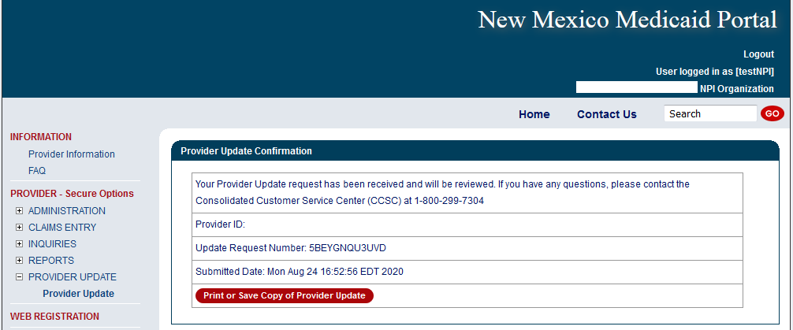
Provider Update Confirmation
Document your Update Request Number for tracking purposes
Notes:
Providers can print or save a copy of the completed 304 form here. The provider’s entry on the page is populated on the MAD 304 electronic form.

Slide 31
Addendum
Conduent
Government Healthcare Solutions

Slide 32
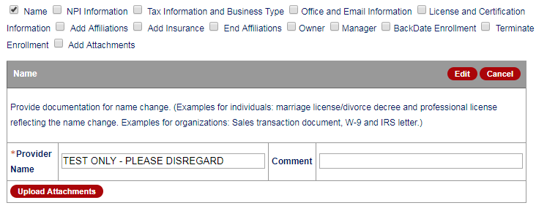
Addendum – “Name”
Available to Billing, Unrestricted, and Rendering Providers

Slide 33
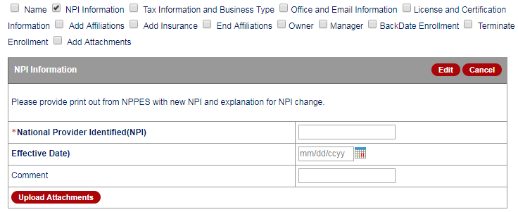
Addendum – “NPI Information”
Available to Billing, Unrestricted, and Rendering Providers

Slide 34
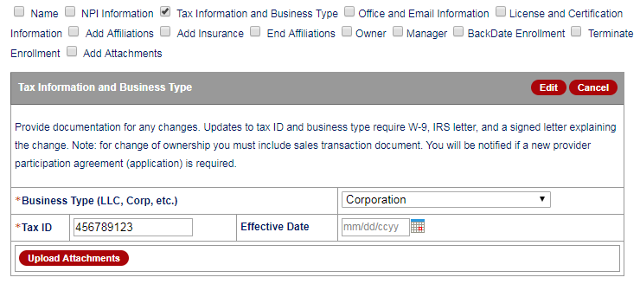
Addendum – “Tax Information and Business Type”
Available to Billing and Unrestricted Providers

Slide 35
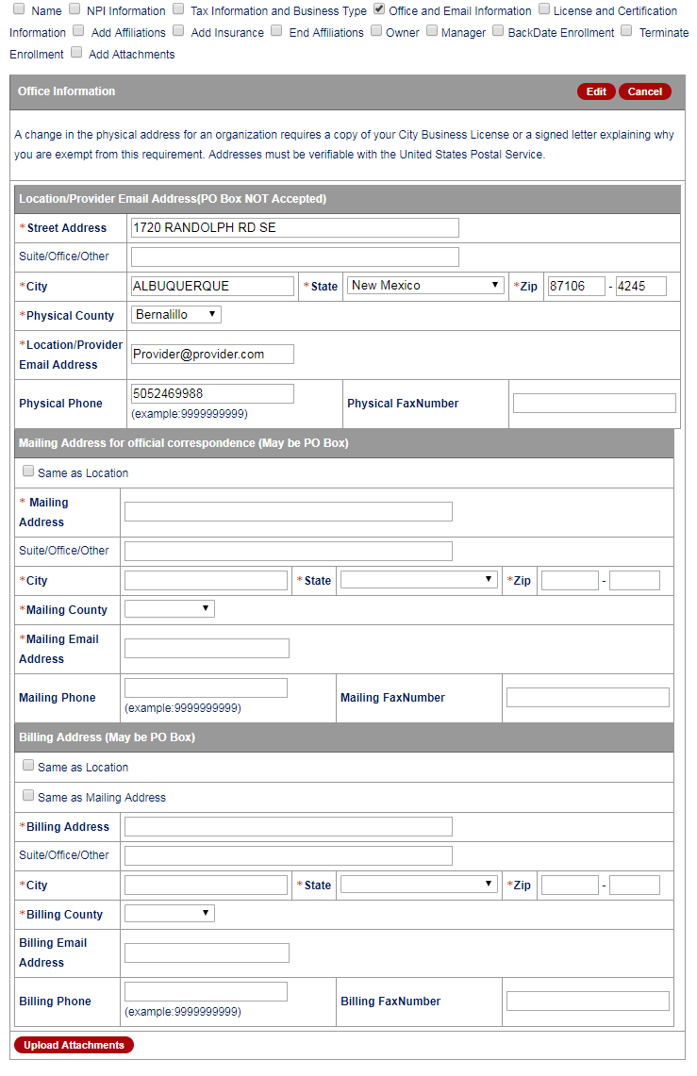
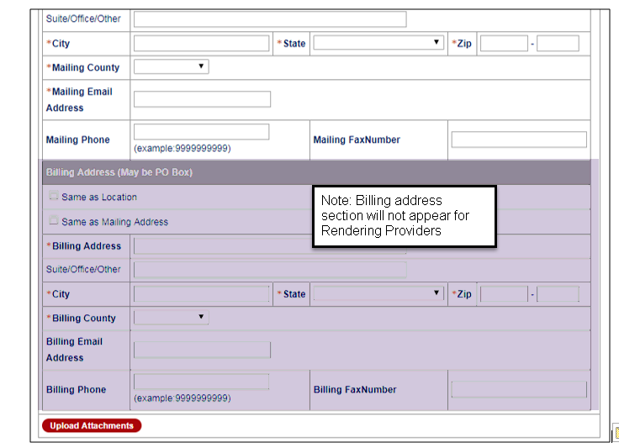
Addendum – “Office and Email Information”
Available to Billing, Unrestricted, and Rendering Providers
Notes:
Billing and Unrestricted providers will have the Billing Address fields. Rendering providers wont.

Slide 36
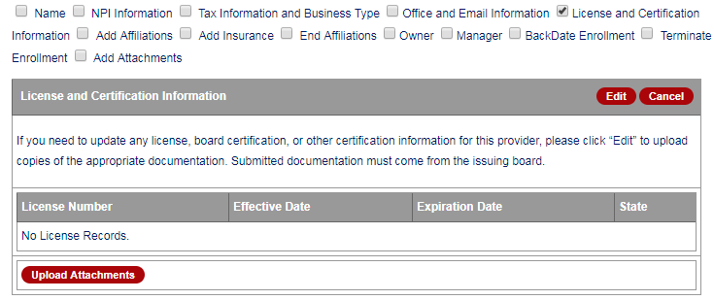
Addendum – “License and Certification”
Available to Billing, Unrestricted, and Rendering Providers

Slide 37
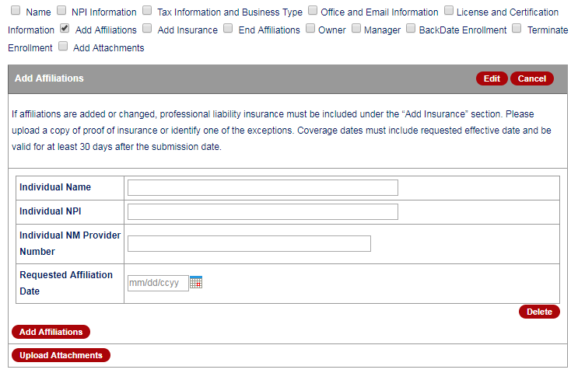
Addendum – “Add Affiliations”
Available to Billing, Unrestricted, and Rendering Providers

Slide 38
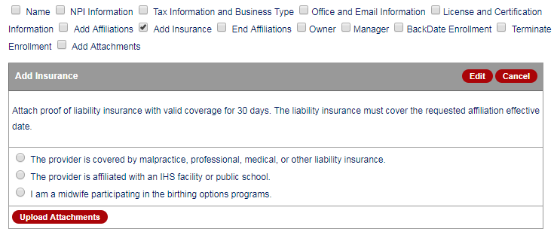
Addendum – “Add Insurance”
Available to Billing, Unrestricted, and Rendering Providers

Slide 39
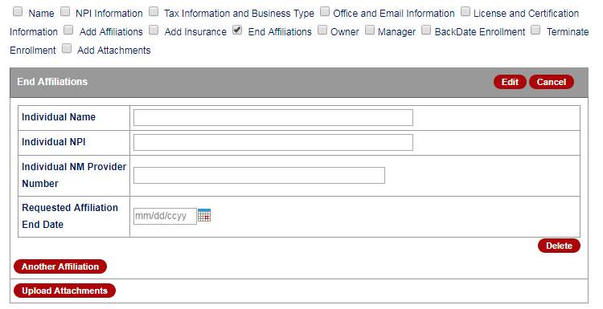
Addendum – “End Affiliations”
Available to Billing, Unrestricted, and Rendering Providers

Slide 40
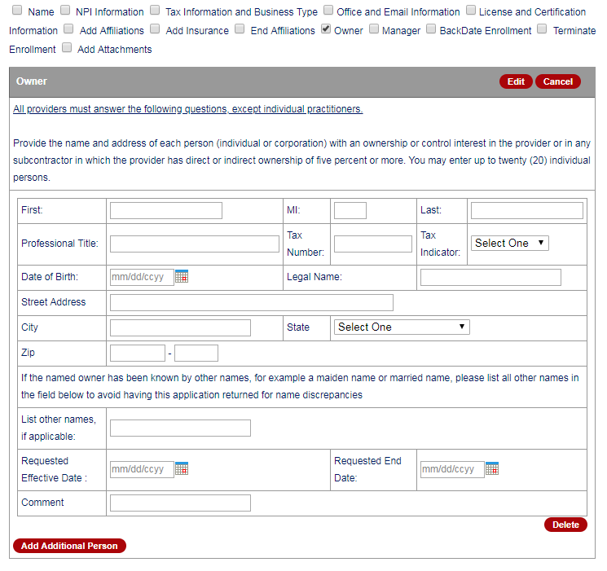
Addendum – “Owner”
Available to Billing and Unrestricted Providers
Notes:
This update is not available to Rendering Providers

Slide 41
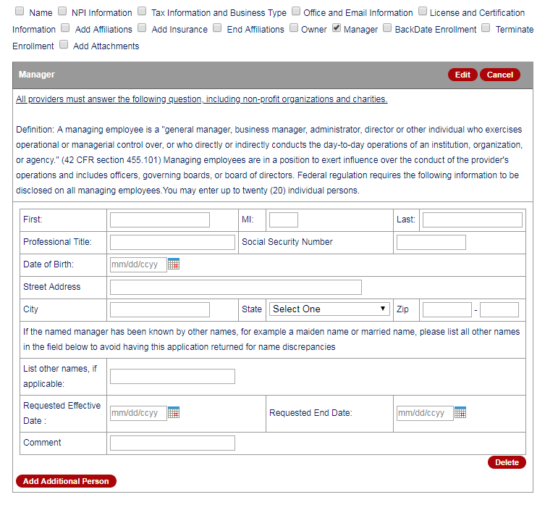
Addendum – “Manager”
Available to Billing and Unrestricted Providers
Notes:
This update is not available to Rendering Providers

Slide 42
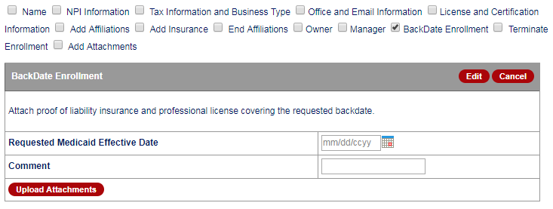
Addendum – “BackDate Enrollment”
Available to Billing, Unrestricted, and Rendering Providers

Slide 43
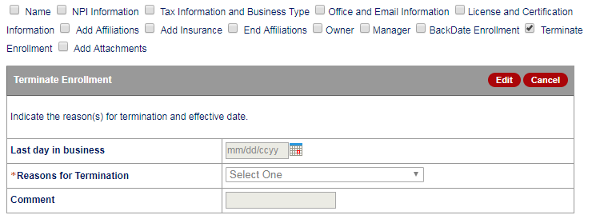
Addendum – “Terminate Enrollment”
Available to Billing, Unrestricted, and Rendering Providers

Slide 44
Addendum – “Add Attachments”
Available to Billing, Unrestricted, and Rendering Providers

Slide 45
New Mexico Medicaid Resources Continued
New Mexico Medicaid Portal – https://nmmedicaid.portal.conduent.com/static/index.htm
Claim Inquiries, Eligibility Verification, Electronic Claim Submission, Provider Manuals, E-News
NM Human Services Department – http://www.hsd.state.nm.us/mad/
Supplements, Memos, Provider Billing Packets and Policy
Medical Assistance Division – PE Program Staff – HSD.PEDeterminers@state.nm.us
Assistance with PE Applications, PE Determinations, MAD 070, PE Training, PE Certification
Consolidated Customer Service Center (CCSC) Helpdesk– (800) 299-7304.
Claim Status, Eligibility, Prior Authorization, Medicaid Updates
Consolidated Customer Service Center (CCSC) Helpdesk – NM.Providers@state.nm.us
Claim research assistance, general Medicaid inquiries, Provider Enrollment Applications, Forms & Instructions
Consolidated Customer Service Center (CCSC) Helpdesk – (800) 283-4465
Eligibility inquiries, Fee-for-Service Replacement Medicaid Identification Card, Enroll or change a Managed Care Organization and Eligibility application status
Medical Assistance Division, Program Rules – http://www.hsd.state.nm.us/providers/rules-nm-administrative-code-.aspx
NMAC for Programs administered by the Medical Assistance Division Yes New Mexico - https://www.yes.state.nm.us/yesnm/home/index Apply, check, update, or renew Medical Assistance (Medicaid) benefits

